Slide 1
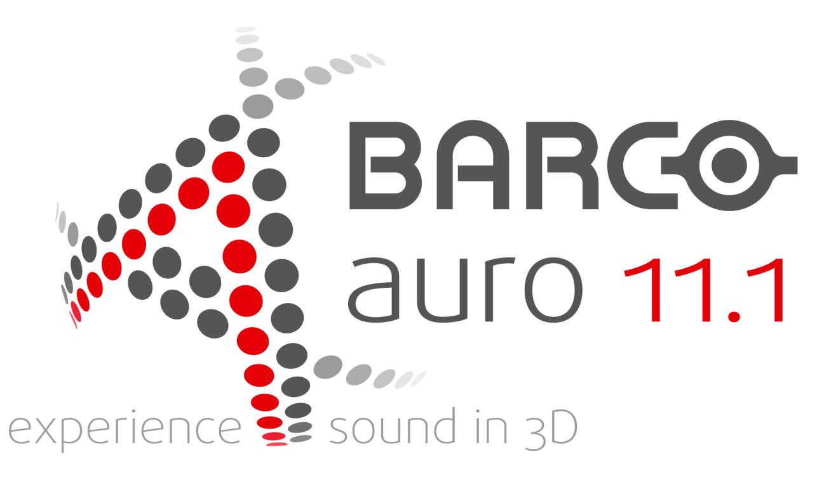

Slide 2
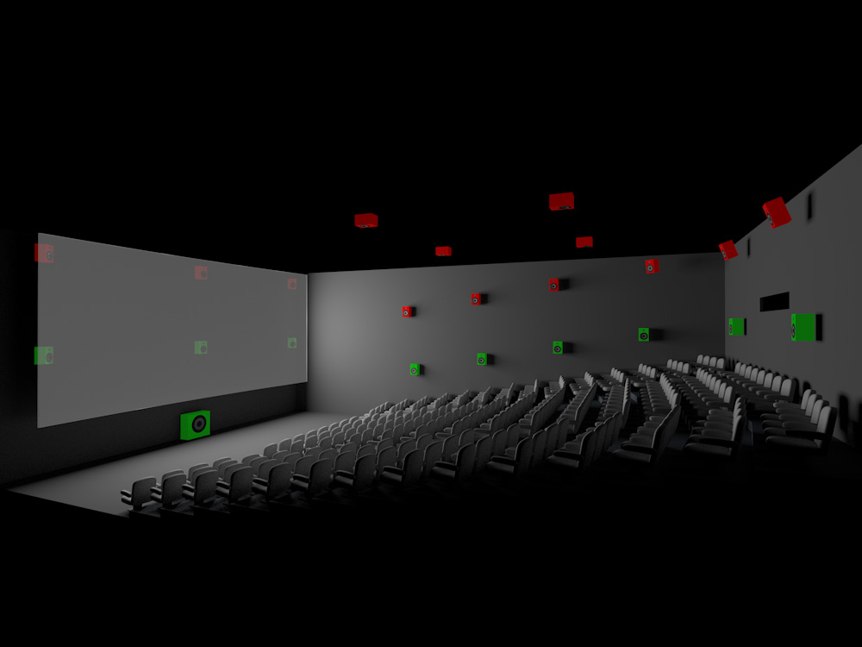
The Auro-11.1 Listening Format
HL
HT
HLs/Rs
HC
HR
Ls/Rs
L
C
R

Slide 3
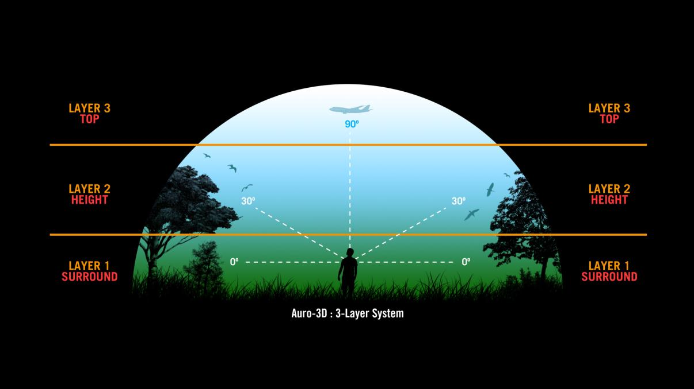
Vision & Concept
Natural sound can be divided into 3 layers

Slide 4
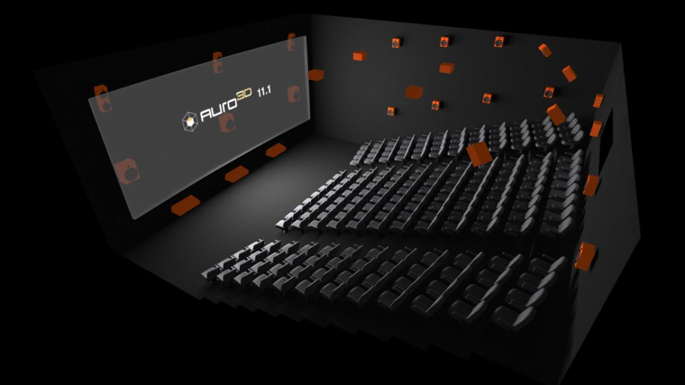
Auro-11.1 Cinema Installation

Slide 5
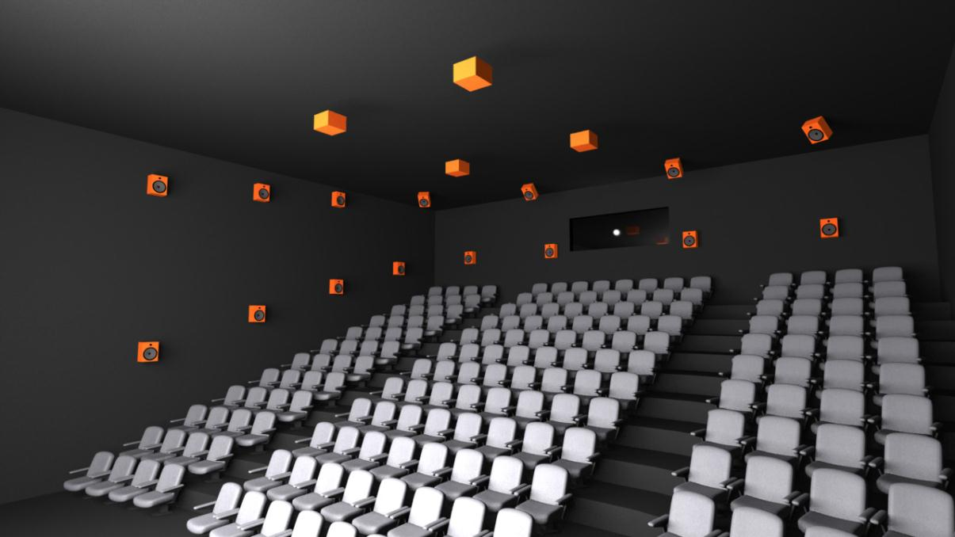
Auro-11.1 Cinema Installation

Slide 6
Auro-11.1 - A Unique Combination of 4 Key Ingredients
#1
Highest Quality
#4
Most Easy-to-Use
#2
Best Compatibility
#3
Best Value for Money

Slide 7
#1 – Highest Quality
#1
Highest Quality
#4
Most Easy-to-Use
#2
Best Compatibility
#3
Best Value for Money
Listening Formats
All Auro-11.1 Listening Formats are ‘channel-based’ systems ➔ more natural versus ‘object-based’ systems
Channel-based systems are the only systems used in the market (stereo, surround 5.1 and 7.1)
Custom created for the Cinema Exhibition Industry…keeping the premium experience in the theater!
Sweet Spot enlarged
Mono Ceiling Overhead provides for a larger sweet spot for a more coherent 3D audio experience
Technical solutions
Natural compatibility with DCI spec➔ Auro uses uncompressed audio
Non Masking, No Psycho acoustical compression ➔ No Quality loss
Up-mixing (up-converting) algorithms for alternative content
Integrated decoder into existing media blocks

Slide 8
#2 – Best Compatibility
#1
Highest Quality
#4
Most Easy-to-Use
#2
Best Compatibility
#3
Best Value for Money
Listening Formats
Full Backwards compatibility with 5.1 Standard and Stereo!
Technical solutions
Natural compatibility with Linear PCM (uncompressed audio)
DCI Compliant: Watermarking included for copy protection of the content
Compatible With existing Production Equipment and workflows

Slide 9
#3 – Best Value for Money
#1
Highest Quality
#4
Most Easy-to-Use
#2
Best Compatibility
#3
Best Value for Money
Installation/ Operation
Upgrade on existing 5.1 Surround systems
Maximum “Sound in 3D” result with a Minimum number of speakers & amplifiers
Non Recussing Licensing Model
No license fee for content creation
Technical solutions
Uses Uncompressed audio (PCM) as the data carrier for Auro 11.1
supported in all Audio Cinema Devices and the DCI spec (standard)
Single Media Distribution (Single Inventory Distribution)
Efficient integration in existing DAW (audio post production workstations) and Software
Maintains existing workflows (only change is some templates)
NO rendering station needed (in post production or at theaters)
NO new media server needed (software upgrade of existing servers)

Slide 10
#4 – Most Easy-to-Use
#1
Highest Quality
#4
Most Easy-to-Use
#2
Best Compatibility
#3
Best Value for Money
Content CREATION is EASY thanks to :
Natural compatibility of the Auro-11.1 speaker layouts with Surround Standards
Easy-to-use creative tools
Ability to remain in the uncompressed audio domain
Content PLAYBACK is EASY thanks to :
One Single Inventory distribution
No mistakes can be made by operators (often occurs with multiple CPLs and KDMs on one DCP)
Real Time 11.1 Up-mix capability for Alternative content!
EASY to INSTALL on ALL existing surround systems
There is always room above the current surround speakers of a 5.1 installed system
Auro-11.1 speaker layouts can be compatible with Dolby Atmos, but Auro soundtracks provide a more immersive experience!

Slide 11
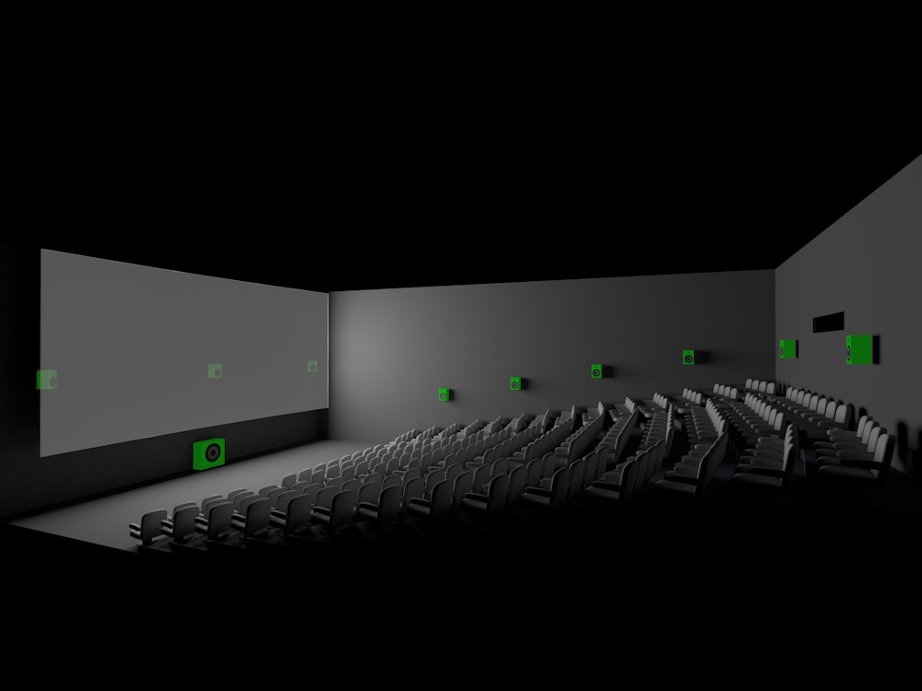
Sound in 3D – “Up Stream” Compatibility
- 5.1 / 7.1

Slide 12
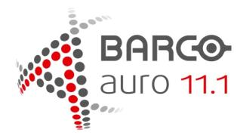
Sound in 3D – “Up Stream” Compatibility
- 5.1 / 7.1

Slide 13
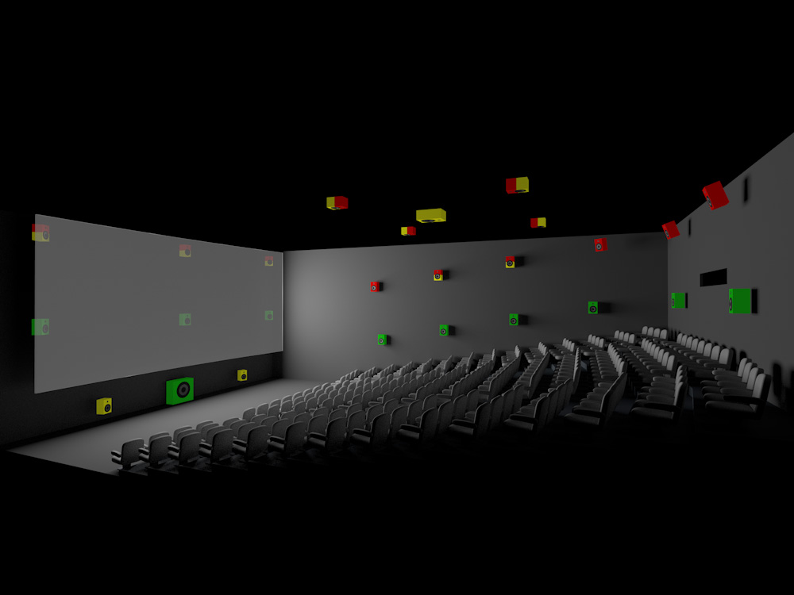
Sound in 3D – “Up Stream” Compatibility
- 5.1 / 7.1
IMMsound 23.1
IMMsound 23.1

Slide 14
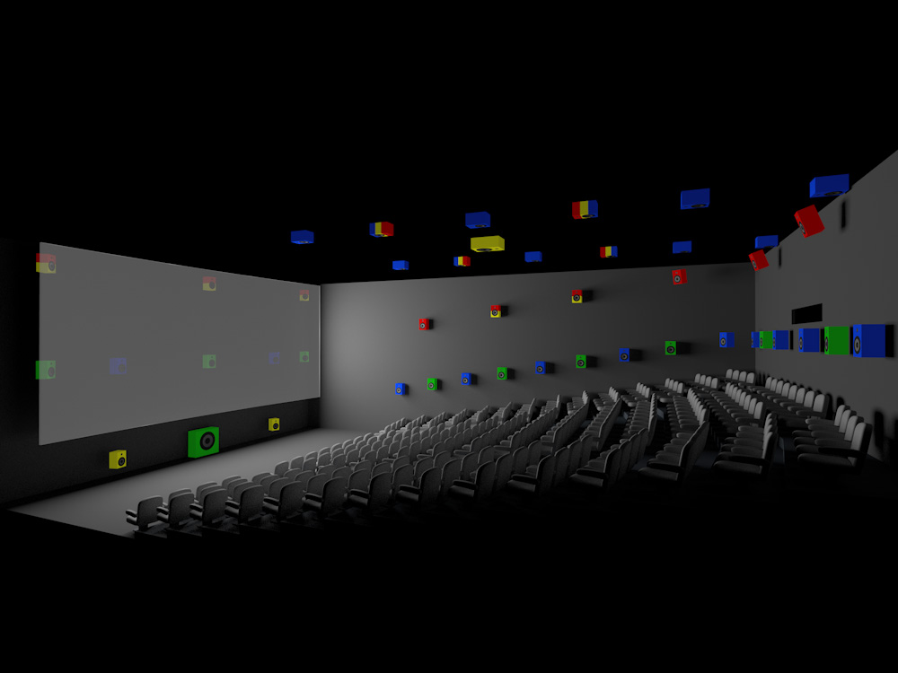
Sound in 3D – “Up Stream” Compatibility
- 5.1 / 7.1
IMMsound 23.1
Atmos 47-64.1

Slide 15
Sound in 3D – “Object Based” versus “Channel Based” Sound
Object Based (Dolby Atmos)
Unique sounds or objects are “steered” around the room based on vector metadata which accompanies the additional audio file in the distribution and renders the sound of a particular object in space.
Base layer 5.1 or 7.1 “beds” accompanies the object sound file and vector metadata. “Beds” contain dialog, music and other sounds that don’t “move” or require steering
Unique distribution, separate KDM/CPL
Requires more unique channels and speakers…24-64
Great for “Dry” Sounds….but “Wet” Sounds cant easily be rendered with meta data
Ok for airplane flying around your head. Not OK for Natural Ambience or sounds rich in reflections (e.g orchestra or crowd)
New workflows and content creation tools are required
“Object metadata” untimately leveraged to improve personal multi media experience
Channel Based (Auro 11.1)
5.1, 7.1, 11.1 are all channel based formats
All objects, ambience, FX, etc are “mixed” in to a predetermined amount of channels by the mixer on a dub stage and played back in a theater with the corresponding channels
Can be easily mixed down to fewer channels or encoded
More compatible with existing production audio equipment and workflows
More capable of handling “Wet” sounds
natural ambiences and effects captured in the native channel count

Slide 16
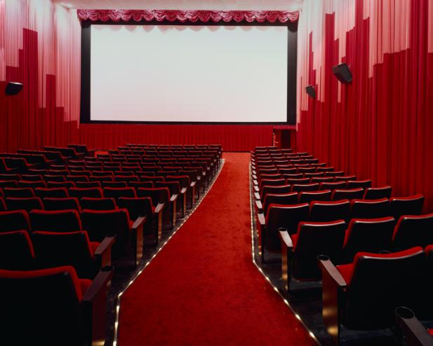
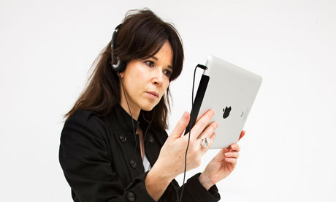
Sound in 3D – “Object Based” versus “Channel Based” Sound
Endorsing object based soundtrack creation risks ultimately loosing theatrical attendance to an “improved” personal multi-media experience …either real or imagined.
?
?

Slide 17
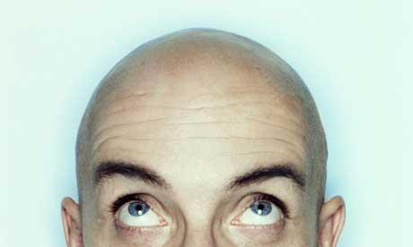
Auro-11.1 - The Most Immersive Experience
One common feedback from listeners who compared the different 3D Audio systems in the market is that the
Auro-11.1 speaker layouts in cinemas are giving the most immersive experience!
Reasons for that are:
All Auro-11.1 Listening Formats have HEIGHT channels AROUND the listener (front, sides & back)
Not ONLY over head
The 30°Vertical Height channels are much more important than the Overhead ceiling channels
WHY????
We don’t have ears on the top of our heads!
Overhead speakers are for SFX…not an ambience enhancement
All Auro-11.1 speaker layouts guarantee the best compatibility with the existing systems which are all channel-based. Object-based spot point sounds risk making 3D sound more of a “gimmick” than a truly immersive experience.
Additionally, Auro-11.1 uses less speakers and amplifiers than competitive systems
More speakers, more channels or object-based technology is more expensive.

Slide 18
Auro 11.1 = DCI COMPLIANT !
Film studios require maximum protection of their content by using “Watermarking”
a forensic system that is adding unique information to the audio signal for each theater every time allowing for analysis of where and when the content was copied
Digital Cinema Initiative (DCI) specs are providing watermarking in the media server on all channels
which allows to recognize the theater and time if somebody recorded the audio in the theater
The Auro-Decoder is embedded in the DSP Watermarking chip.
➔Will Object based systems put the watermark on all 23-64 channels to be compliant with the DCI spec?
AURO 11.1 IS THE ONLY DCI COMPLIANT next generation audio architecture in the market today

Slide 19
Auro-11.1 = SINGLE MEDIA DISTRIBUTION
AUTHORING = JUST ONE DCP (Single Inventory Distribution)
Similar to normal workflow
Just ONE KDM
NO licensing FEE
JUST ONE PCM CARRIER : 5.1 Surround or 7.1 Surround
5.1 SURROUND WILL PLAYBACK ON EACH VENUE
AUTOMATIC PLAYBACK of the AURO 11.1 ORIGINAL MIX if Auro-decoder is installed
THE ONLY VIABLE SOLUTION TO COMBINE MULTIPLE FORMATS IN ONE DISTRIBUTION

Slide 20
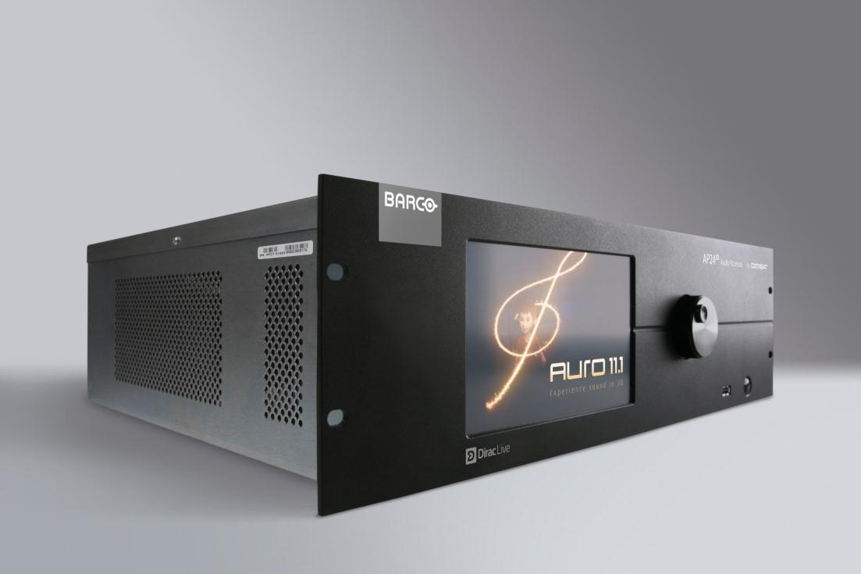
Auro-11.1 = THE SUPERIOR SOLUTION
HIGHEST QUALITY
BEST COMPATIBILITY
MOST ECONOMIC
AVAILABLE NOW

